Slide 1
Analyzing Facebook Live Sellers: Insights from Thai Fashion and Cosmetics Retailers

Slide 2
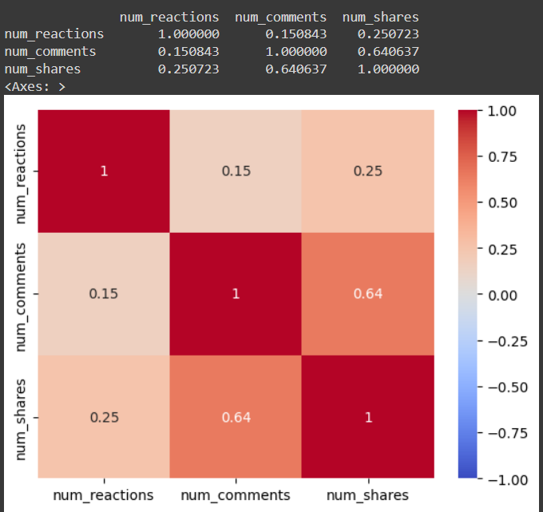
Analyzing the Correlation Between Reactions and Other Engagement Metrics
Number of reactions and number of comments:
Correlation Coefficient: 0.151
Strength: Weak
Direction: Positive
Number of reactions and number of shares:
Correlation Coefficient: 0.251
Strength: Weak
Direction: Positive
Number of comments and number of shares:
Correlation Coefficient: 0.641
Strength: Moderate
Direction: Positive

Slide 3
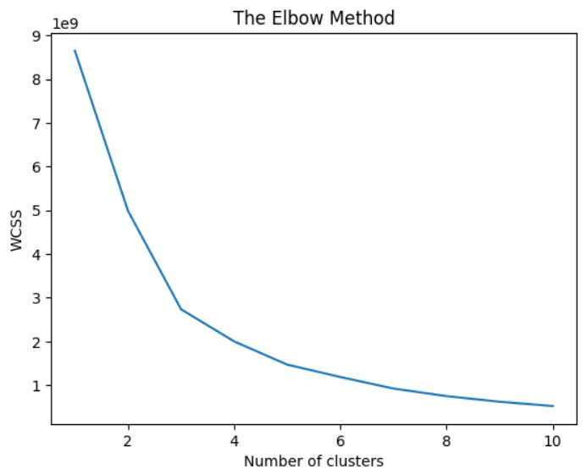
Training a K-Means Clustering Model on Facebook Live Sellers Data
The plot shows that the optimum number of clusters is '5'
Therefore, a K-Means cluster model with 5 clusters has been used and accuracy has been measured

Slide 4
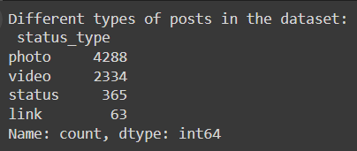
Distribution of Post Types in the Dataset
'Photos' are the most common posts in the dataset while 'Links' are the least common.
The count of each type of posts has been specified

Slide 5
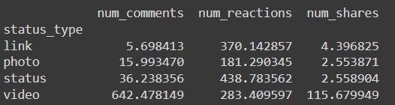
Average Engagement Metrics by Post Type
Link
Average Comments: 5.70
Average Reactions: 370.14
Average Shares: 4.40
Photo
Average Comments: 15.99
Average Reactions: 181.29
Average Shares: 2.55
Status
Average Comments: 36.24
Average Reactions: 438.78
Average Shares: 2.56
Video
Average Comments: 642.48
Average Reactions: 283.41
Average Shares: 115.68

